Slide 1
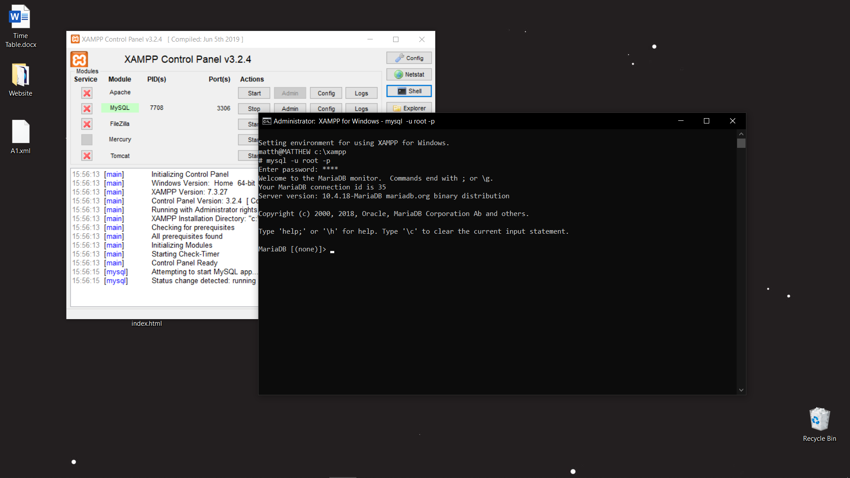
LOCAL CONNECTION

Slide 2
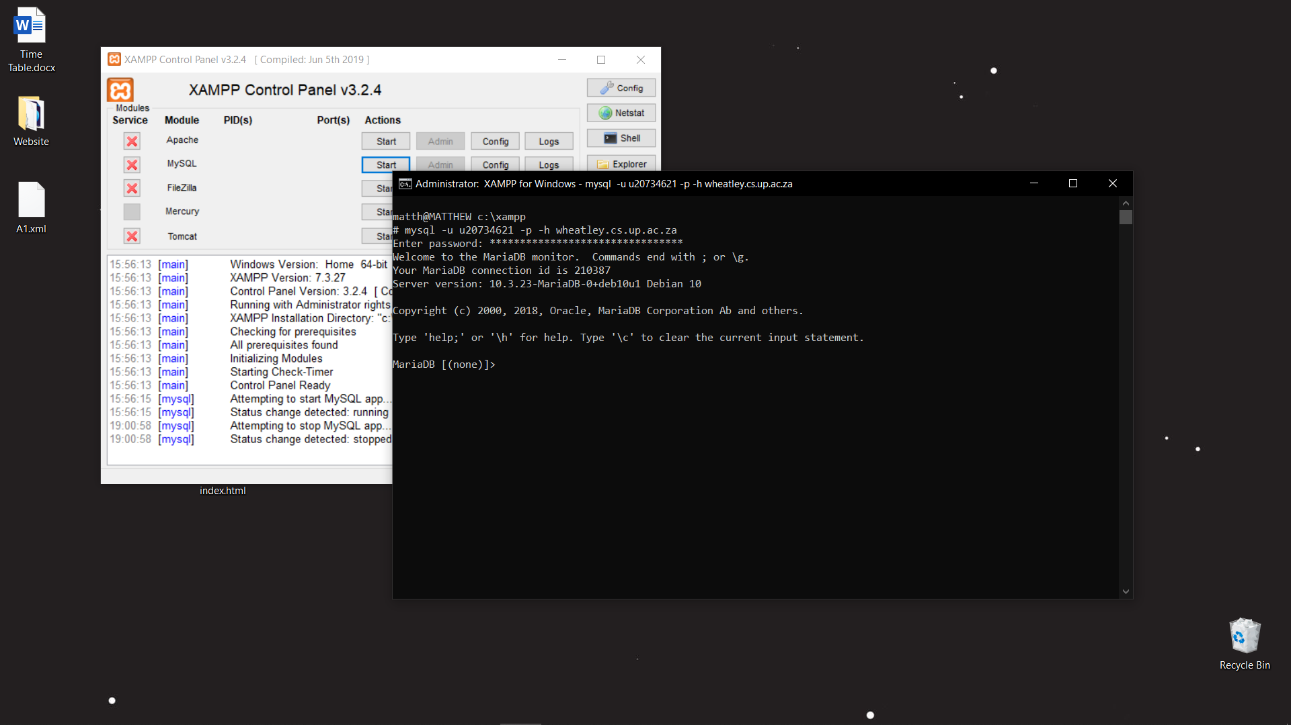
WHEATLEY CONNECTION

